Slide 1
SQL Azure Database
Lessons learned from the trenches working with V12
José Manuel Jurado
SQL Support Engineer
Subject Master Expert SQL Azure

Slide 2
3 Sponsor Sessions at 11:15
Don’t miss them, they might be getting distributing some awesome prizes!
HP
SolidQ
Pyramid Analytics
Also Raffle prizes at the end of the event provided by
HP, SolidQ, Pyramid Analytics, Altran & Microsoft

Slide 3






Our Main Sponsors:

Slide 4
Session Objectives And Takeaways
Session Objectives:
Raise awareness of SQL Azure common issues, help to improve customer’s business continuity and prevent SQL Azure performance issues.
Key Takeaway 1.
New Options in v12 / Options saving DBA time.
Key Takeaway 2.
New diagnostic tools for performance for you.
Key Takeaway 3.
New database models and business continuity.
4 |

Slide 5

Questions
Did you work with SQL Azure previously?
If not, do you know what is it?
There is not needed to answer (now): Did you have any trouble or issue working with SQL Azure previously?
5 |

Slide 6
Azure - Terms
Traditional Schema
Infrastructure
(as services)
Platform (as service)
Software
(as service)
User Adminiostration
Applications
User Administration
Applications
Applications
Applications
Data
Data
Data
Data
Runtime
Runtime
Runtime
Runtime
User Administration
Provider Administation
Middleware
Middleware
Middleware
Middleware
Provider Administration
Ops.System
Ops.System
Ops.System
Ops.System
Virtualization
Virtualization
Provider Administration
Virtualization
Virtualization
Servers
Servers
Servers
Servers
Storage
Storage
o
Storage
Storage
Network
Network
Network
Network

Slide 7

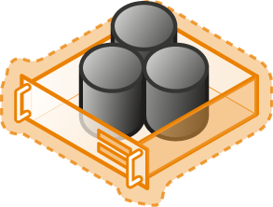

Azure – Database Platform
Hybrid Cloud
Managed database service
Focus on business logic
WA SQL Database - PaaS
Virtualized Database
100% Compatibility
Rapid self-service provisioning
Shared Lower cost
SQL Server in WA VM - IaaS
Virtualized Machine
Elastic/Self-Service capabilities
Full h/w control
Virtualized Machine
SQL Server Private
Full h/w control
Roll-your-own HA/DR/scale
Dedicated Higher cost
SQL Server
Physical Machine (raw iron)
Low Control
High Control

Slide 8
Agenda
Differences with V11.
New database tiers.
Improvements:
Connectivity.
Engine.
Security.
Tools.
High Availability and Disaster Recovery.
8 |

Slide 9

SQL Azure V12
Differences with V11
9 |
Notes:
Using DMVs

Slide 10
Differences with V11 – The Good
No noisy neighbors.
Instance per database non-shared.
20%-30% improvement.
Direct connection and differences depending on data provider.
Predictive performance.
DTUs – Data Throughput Unit
10 |

Slide 11
Differences with V11 – The Good
SELECT end_time , (SELECT Max(v) FROM (VALUES (avg_cpu_percent) , (avg_data_io_percent) , (avg_log_write_percent) ) AS value(v)) AS [avg_DTU_percent] FROM sys.dm_db_resource_stats ORDER BY end_time DESC;
Tip:To find a resource usage:
sys.dm_db_resource_stats. Has 15 second granularity.
sys.resource_stats has 5 minute granularity.
sys.elastic_pool_resource_stats for elastic pool databases.
sys.dm_os_performance_counters - http://blogs.msdn.com/b/dfurman/archive/2015/04/02/collecting-performance-counter-values-in-sql-azure.aspx
11 |

Slide 12
Differences with V11 – The Good
Our customer is able to restore backups.
Dedicated Administrative Connection.
A lot of new DMVs. https://azure.microsoft.com/en-gb/documentation/articles/sql-database-v12-whats-new/
Heap Table – No needed clustered index.
MAXDOP >1.
Own Parallel Data Warehouse - called SOS Datawarehouse … Test it!!!
12 |
Notes:
admin:xxxxxx.database.windows.net
SSMS Supported 2014+CU6

Slide 13
Differences with V11 – The Good
Remote Querying:
Announcement blog post: https://azure.microsoft.com/en-us/blog/querying-remote-databases-in-azure-sql-db/
Step-by-step tutorial: https://azure.microsoft.com/en-us/documentation/articles/sql-database-elastic-query-getting-started-vertical/
Overview documentation: https://azure.microsoft.com/en-us/documentation/articles/sql-database-elastic-query-vertical-partitioning/
13 |
Notes:
admin:xxxxxx.database.windows.net
SSMS Supported 2014+CU6

Slide 14
Differences with V11 – The Good
Deleted database.
Tip:If you drop a server you wouldn’t be able to reuse the name after 5 days.
Elastic Jobs my SQL Agent.
Overview https://azure.microsoft.com/en-us/documentation/articles/sql-database-elastic-jobs-overview/
Tip: Using Linked Server either SSIS or SQL Agent are our workarounds.
14 |
Notes:
admin:xxxxxx.database.windows.net
SSMS Supported 2014+CU6

Slide 15
Differences with V11 – The Bad
Compare Basic/Standard vs Web/Business.
Tip: Update stats, rebuild index, missing index. http://blogs.msdn.com/b/sqlblog/archive/2013/11/01/do-i-need-to-upgrade-my-dba-skills-for-the-cloud.aspx
Postpone the migration from V11 to V12: http://blogs.msdn.com/b/azuresqldbsupport/archive/2015/06/05/stopping-or-postponing-an-upgrade-to-sql-database-v12.aspx
Business and Web will be migrated in automatic way started at: 12th September - https://azure.microsoft.com/en-us/blog/azure-sql-database-web-and-business-edition-retirement-september-12th-2015/
Retry-Logic is more needed than before.
Once moved V12 not possible to go back.
15 |

Slide 16
Differences with V11 – The Bad
BulkCopy works but not loading entire files you could use bcp instead of.
No more federations, now, Sharding framework. https://azure.microsoft.com/en-us/documentation/articles/sql-database-elastic-scale-use-entity-framework-applications-visual-studio/
Lost HTML to manage the database.
16 |

Slide 17
Differences with V11
DEMO
17 |
Notes:
Using DMVs

Slide 18

SQL Azure V12
New Database Tiers
18 |
Notes:
Using DMVs

Slide 19
New Database Tiers
Basic/Standard vs Web/Business
Premium P6 y P11
Elastic Database Pool
19 |

Slide 20
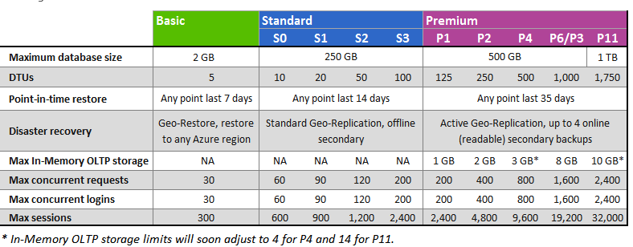
New Database Tiers - Basic/Standard
20 |

Slide 21
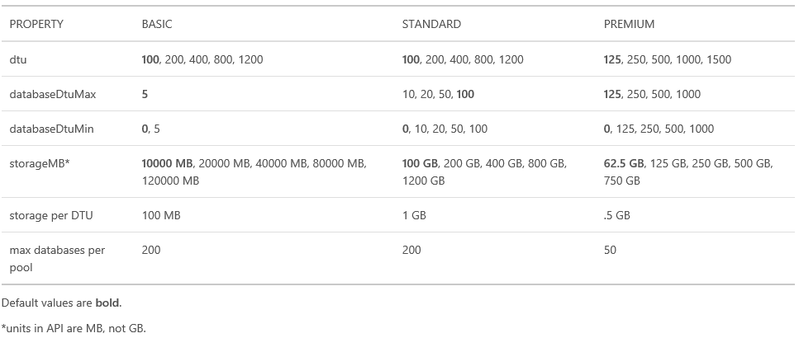
New Database Tiers – Elastic Pool
21 |

Slide 22
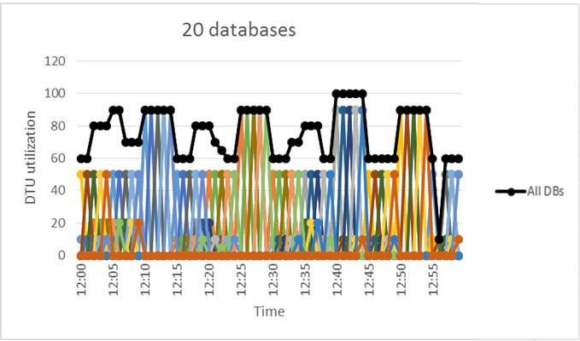
New Database Tiers – Elastic Pool
22 |

Slide 23

SQL Azure V12
Improvements
23 |
Notes:
Using DMVs

Slide 24
Connectivity – Tips and Tricks
https://dbstresstest.codeplex.com/ for playing with the connections, connection pooling, limitation of database tier per session, etc..
The SQLConnection object has some properties explained at: https://msdn.microsoft.com/en-us/library/7h2ahss8(v=vs.110).aspx where you could obtain a good indicators about the connectivity, network server time, duration, etc.. in similar way when we are working enabling the SET STATISTICS … in SQL Server Management Studio.
To measure the time spent customer are using a tool called Stopwatch https://msdn.microsoft.com/en-us/library/system.diagnostics.stopwatch(v=vs.110).aspx
24 |

Slide 25
Connectivity – Tips and Tricks
Documentation on handling connections to Azure SQL Db: https://azure.microsoft.com/en-us/documentation/articles/sql-database-connect-central-recommendations
Retry logic for Azure SQL Db: http://social.technet.microsoft.com/wiki/contents/articles/4235.retry-logic-for-transient-failures-in-windows-azure-sql-database.aspx
Error Code List for Retry Logic in Azure SQL Db: https://azure.microsoft.com/en-us/documentation/articles/sql-database-develop-error-messages/
SqlConnection.ClearPool(cnn) - To clean up the connection from the connection pool using SqlConnection.ClearPool(cnn) - http://blogs.msdn.com/b/bartr/archive/2010/06/18/sql-azure-connection-retry.aspx
25 |

Slide 26
Engine
XML Data Type
Partial FullText Support.
Contained Databases.
Partitioning Tables.
ColumnStore Index
In-Memory tables
CLR Integration
26 |

Slide 27
Engine - Tips &Tricks
Others:
Azure SQL database calculator tool to migrate VM Machines http://dtucalculator.azurewebsites.net/
Deadlock:
SELECT *, CAST(event_data as XML).value('(/event/@timestamp)[1]', 'datetime2') AS timestamp ,CAST(event_data as XML).value('(/event/data[@name="error"]/value)[1]', 'INT') AS error
,CAST(event_data as XML).value('(/event/data[@name="state"]/value)[1]', 'INT') AS state ,CAST(event_data as XML).value('(/event/data[@name="is_success"]/value)[1]', 'bit') AS is_success ,CAST(event_data as XML).value('(/event/data[@name="database_name"]/value)[1]', 'sysname') AS database_name
FROM sys.fn_xe_telemetry_blob_target_read_file('el', null, null, null)
where object_name = 'database_xml_deadlock_report'
27 |

Slide 28
Engine - Tips &Tricks
Others:
ALTER DATABASE [DDBB] SET COMPATIBILITY_LEVEL = 110;
Database compatibility level 120 uses a new cardinality estimator that is tuned for modern data warehousing and OLTP workloads. Before setting database compatibility level to 110 because of performance issues.
28 |

Slide 29
Engine
DEMO
29 |
Notes:
XML.sql
Partition.sql
FullText.Sql
Contained.SQL
ColumnStoredIndex.SQL

Slide 30
Security
Row Level Security.
Dynamic Data Masking.
SQL Auditing & Threat detection.
TDE – Transparent Data Encryption.
SQL Always Encrypted.
Azure Active Directory.
Others: GreenSQL proxy connection.
30 |
Notes:
Row Level Security: https://msdn.microsoft.com/en-US/library/mt130841(SQL.130).aspx

Slide 31
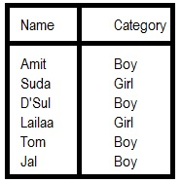
Security
TDE (all data files)
Dynamic Data
Masking
(function)
ROW LEVEL
Column Encrypted Certificate.
31 |
Notes:
Row Level Security: https://msdn.microsoft.com/en-US/library/mt130841(SQL.130).aspx

Slide 32
Security Tips & Tricks
Auditing in this URL: https://azure.microsoft.com/en-us/documentation/articles/sql-database-auditing-get-started/ there is a link document about the activities and events audited line Audit Log Format Reference (doc file download).
32 |
Notes:
Row Level Security: https://msdn.microsoft.com/en-US/library/mt130841(SQL.130).aspx

Slide 33
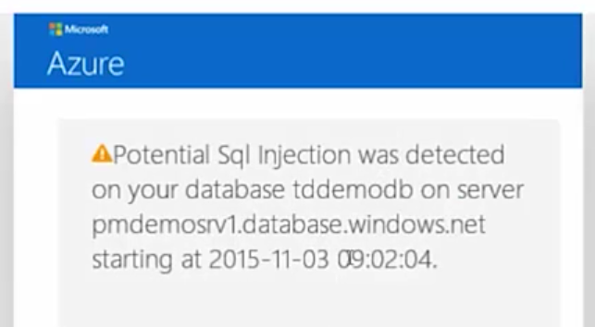
Security
33 |
Notes:
Row Level Security: https://msdn.microsoft.com/en-US/library/mt130841(SQL.130).aspx

Slide 34
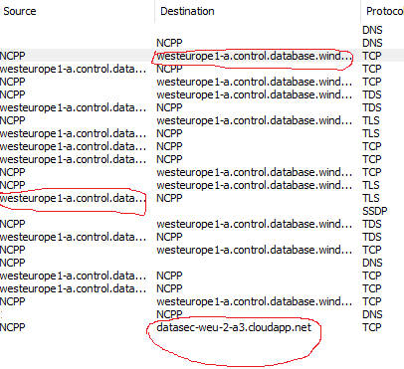
Security - Tips & Tricks
Auditing TCP Conversation: Be aware of
34 |
Notes:
Row Level Security: https://msdn.microsoft.com/en-US/library/mt130841(SQL.130).aspx

Slide 35
Security
DEMO
35 |
Notes:
XML.sql
Partition.sql
FullText.Sql
Contained.SQL
ColumnStoredIndex.SQL

Slide 36
Tools
Query Data Store & Workload Insights https://azure.microsoft.com/en-us/blog/query-store-a-flight-data-recorder-for-your-database/
Extended Events https://azure.microsoft.com/en-us/documentation/articles/sql-database-xevent-code-event-file/
Index Advisor
Portal Alerts
PssDiag for SQL Azure & SQL Nexus https://sqlnexus.codeplex.com/ http://diagmanager.codeplex.com http://pal.codeplex.com
36 |
Notes:
QDS: https://msdn.microsoft.com/en-us/library/mt604821.aspx#Anchor_4
https://msdn.microsoft.com/en-us/library/dn818146.aspx
Extended Events:https://azure.microsoft.com/en-us/documentation/articles/sql-database-xevent-code-event-file/

Slide 37
Code Best Practices – Tips & Tricks
Batching considerations: https://azure.microsoft.com/en-us/documentation/articles/sql-database-use-batching-to-improve-performance/
Performance considerations: https://azure.microsoft.com/en-us/documentation/articles/sql-database-performance-guidance/
To avoid any parameter sniffing issue. http://blogs.technet.com/b/mdegre/archive/2012/03/19/what-is-parameter-sniffing.aspx
37 |
Notes:
QDS: https://msdn.microsoft.com/en-us/library/mt604821.aspx#Anchor_4
https://msdn.microsoft.com/en-us/library/dn818146.aspx
Extended Events:https://azure.microsoft.com/en-us/documentation/articles/sql-database-xevent-code-event-file/

Slide 38
Entity Framework - Tips & Tricks
Link describing Performance Considerations with Entity Framework – with regards to optimize query performance and model. http://msdn.microsoft.com/en-us/library/cc853327.aspx
38 |
Notes:
QDS: https://msdn.microsoft.com/en-us/library/mt604821.aspx#Anchor_4
https://msdn.microsoft.com/en-us/library/dn818146.aspx
Extended Events:https://azure.microsoft.com/en-us/documentation/articles/sql-database-xevent-code-event-file/

Slide 39
Tools
DEMO
39 |
Notes:
XML.sql
Partition.sql
FullText.Sql
Contained.SQL
ColumnStoredIndex.SQL

Slide 40

SQL Azure V12
High Availability and DR
40 |
Notes:
Using DMVs

Slide 41
SQL Azure V12 – High Availability and Disaster Recovery
SQL Azure HA and DR is in our DNA.
Geo-Replication – more than 1 replica (Online). http://blogs.msdn.com/b/timomta/archive/2015/03/26/script-to-perform-azure-sql-premium-failover.aspx
Geo-Restore.
All database backups are geo-replicated. SQL DB supports geo-restore – eg: any database can be restored anywhere in the world. https://azure.microsoft.com/en-us/documentation/articles/sql-database-business-continuity/
Transactional Replication. https://channel9.msdn.com/Shows/Data-Exposed/Azure-SQL-DB-Transactional-Replication
SQL DataSync is possible to use but not supported.
Replication between databases. Others: DBMoto
Total Disaster of the DataCenter.
41 |

Slide 42
High Availability & Disaster Recovery
DEMO
42 |
Notes:
XML.sql
Partition.sql
FullText.Sql
Contained.SQL
ColumnStoredIndex.SQL

Slide 43
SQL Azure V12
Q&A
If you have any question, please send an email
jmjurado@microsoft.com
43 |
Notes:
XML.sql
Partition.sql
FullText.Sql
Contained.SQL
ColumnStoredIndex.SQL

Slide 44
SQL Azure V12
Thanks!!

